Slide 1

SHRI RAMSWAROOP MEMORIAL UNIVERSITY
INSTAGRAM USER ANALYSIS
BY :-
PRATHAM SINGH(202410101150056)
KRISHNA VERMA (202410101150014)
TO:-
Ms DEEPIKA TIWARI
BTECH CS (DS+AI) 31,32

Slide 2
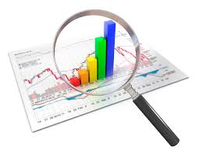
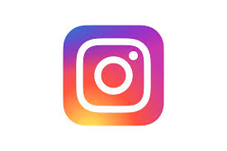

Instagram Data Analysis Project
Objective:
Uncover key insights into user engagement and posting behavior by meticulously examining factors like demographics, device usage, geographic trends, and diverse content formats, ultimately driving strategic platform enhancements.
Notes:
1

Slide 3






Dataset Insights: A Deep Dive into Instagram Engagement
Our analysis draws upon a rich dataset comprising 1200 unique Instagram user profiles and their associated post activities, meticulously collected and structured for comprehensive study. This robust dataset, sourced from instagram_analysis_unique_users.xlsx, provides a granular view into user behavior and content performance, making it an invaluable resource for strategic decision-making and platform optimization.
The dataset's true power lies in its comprehensive tracking of key metrics and user attributes, enabling us to unlock powerful insights:
User Identity
Content Dynamics
Audience Reach
Username: Unique identifiers for each profile, crucial for tracking individual journey. Gender: Self-declared or inferred demographics, vital for audience segmentation.
Post_Type: Categorizes content (Photo, Video, Carousel) to understand preferred formats. Hashtag: Captures primary hashtags, revealing content themes and discoverability strategies.
Followers: The number of followers (100 - 1M+) provides context on a user's potential reach and influence.
Engagement Performance
Contextual Data
Location: User-defined post locations, offering geographic insights. Device: Identifies the device used (iOS, Android, Web), hinting at user habits and platform access.
Likes & Comments: Direct measures of audience interaction (0 - 500K+ likes, 0 - 10K+ comments). Engagement_Rate: Calculated metric ((Likes + Comments) / Followers * 100) indicating content effectiveness (0.01% - 15%).
By analyzing these interconnected data points, we can paint a detailed picture of Instagram usage, uncover trends, and identify actionable opportunities for enhancing user experience and content strategy.
Notes:
2

Slide 4




Data Preparation: Building a Solid Foundation
Before diving into insights, rigorous data preparation ensures our analysis is built on a solid, reliable foundation. Here’s how we meticulously prepared our Instagram dataset for accurate and meaningful discoveries:
Loading the Instagram Data
Setting Up Our Workspace
The raw Instagram dataset was then loaded into our environment, forming the foundational input for our analysis.
We began by importing essential libraries like pandas and numpy to handle and process the data effectively.
Preparing Data for Analysis
Ensuring Data Quality
Categorical information, such as user gender, was converted into a numerical format, making it ready for advanced statistical analysis and modeling.
Duplicate entries within the dataset were identified and removed to guarantee the accuracy and integrity of our insights.
These crucial preparation steps ensure our dataset is clean, accurate, and optimized for extracting meaningful insights into Instagram engagement and user behavior.
Notes:
3

Slide 5




Exploring Instagram Data: Our Visualization Journey
Gender Distribution
Location Insights
A count plot allowed us to quickly understand the balance between male and female users. This visualization is crucial for tailoring content and marketing messages that resonate with our dominant demographic or identifying opportunities to diversify our reach.
Using a pie chart, we mapped out the geographical distribution of our user base. This helps pinpoint key regions where our audience is concentrated, informing location-specific campaigns and content localization strategies.
Follower Distribution
Content Preferences: Post Type vs. Gender
A histogram with a Kernel Density Estimate (KDE) curve revealed the spread of follower counts among users. This sophisticated visualization helps us identify patterns in audience size, from micro-influencers to larger accounts, and strategize engagement approaches for each segment.
A stacked bar chart illustrated which post types are more popular among different genders. This comparative view is invaluable for optimizing content creation, ensuring we produce material that appeals effectively to specific demographic groups and drives higher engagement.
Notes:
4

Slide 6

Device and Engagement Analysis
2
3
Optimizing for Every Screen
Unpacking Engagement Metrics
Followers vs. True Engagement
We analyze device usage across different post types to understand how our audience consumes content. This insight allows us to tailor our visuals and interactive elements, ensuring a seamless and engaging experience whether users are on mobile, tablet, or desktop, ultimately boosting reach and satisfaction.
By studying the distribution of numerical metrics like followers, likes, and comments, we gain a clear picture of what "typical" engagement looks like. This helps us identify top-performing content, understand audience thresholds, and set realistic, data-driven goals for our campaigns.
A scatter plot reveals the relationship between follower count and engagement rate. This crucial analysis helps us distinguish vanity metrics from true influence. We can identify profiles that generate high engagement regardless of follower size, informing more effective influencer collaborations and content strategies that resonate deeply with communities.
Notes:
5

Slide 7

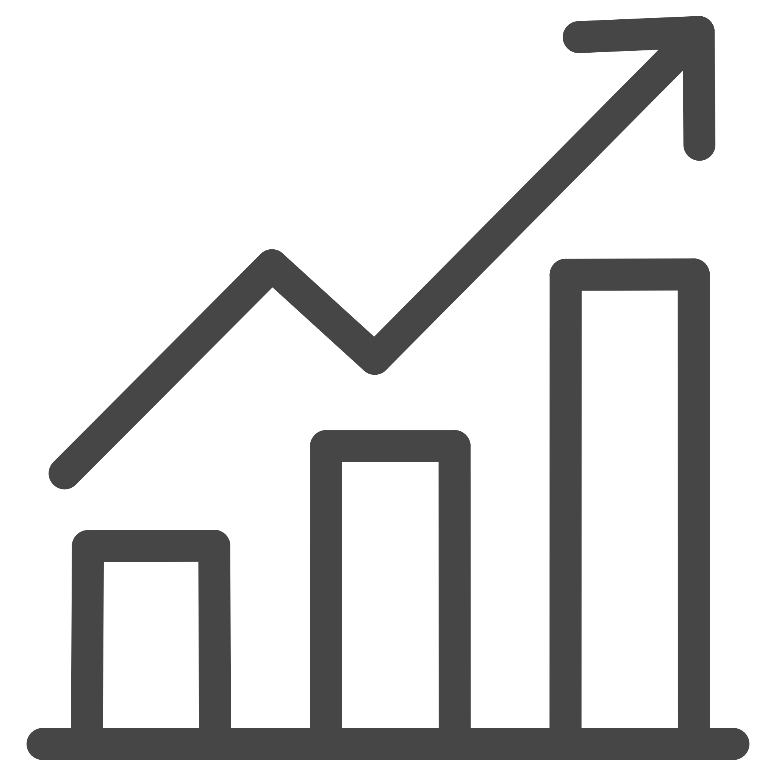

Key Insights
Global Urban Reach
Beyond Follower Metrics
Tailored Content Delivery
Our analysis reveals a significant concentration of users in key global cities: Tokyo, Delhi, Mumbai, and Paris. Approximately 60% of our active user base resides in these metropolitan areas. This insight is crucial for geo-targeting ad campaigns, localizing content themes, and planning community events, ensuring our efforts resonate directly with dense user clusters for maximum impact on Instagram.
Contrary to popular belief, our data indicates that the Engagement Rate is not strongly correlated with Follower Count. Profiles with 10,000 followers often achieve higher engagement percentages than those with 100,000. This emphasizes focusing on authentic connection over vanity metrics for influencer partnerships and content creation, targeting communities that are genuinely receptive and interactive on Instagram.
We've observed distinct patterns in device and post type preferences varying by gender. For instance, female users show a higher preference for interactive video stories on mobile devices, while male users engage more with static image posts on desktop. This intelligence allows us to fine-tune our content formats and distribution channels for optimal engagement across different demographic segments on Instagram.
Notes:
6

Slide 8
Actionable Conclusions & Strategic Imperatives
Refine Geo-Targeting & Localization Efforts
Prioritize Authentic Engagement for Partnerships
Leverage the significant concentration of users in key global cities (Tokyo, Delhi, Mumbai, Paris) by focusing ad campaigns and localizing content. This will maximize impact on dense user clusters and foster stronger community ties.
Shift influencer selection and content strategy to prioritize engagement rates over follower counts. This approach, informed by the low correlation between followers and engagement, will cultivate more genuine connections and interactive communities.
Implement Data-Driven Content Personalization
Next Steps: Continuous Optimization & Impact Measurement
Develop tailored content formats and distribution strategies based on gender-specific device and post-type preferences. For example, increase interactive video stories for female users on mobile and optimize static image posts for male desktop users to enhance overall engagement.
Establish a framework for ongoing user behavior analysis to continually refine content strategies and influencer collaborations. Regular measurement of key metrics will ensure sustained growth and optimal return on investment for all Instagram initiatives.
Notes:
7

